Slide 1
PSORIATIC ARTHRITIS
Dr. Husham Aldaoseri
19/Oct./2023

Slide 2
Spondyloarthritis (SpA)
Undifferentiated
SpA (uSpA)
Juvenile SpA
Ankylosing
spondylitis (AS)
PsA
Reactive
arthritis
Arthritis
associated with
IBD

Slide 3
Psoriasis (Pso)
Psoriasis affects 1-3% of population
26% of patients with Psoriasis will develop arthritis
Psoriatic Arthritis (PsA)
A chronic and inflammatory arthritis in association with skin psoriasis
Psoriatic arthritis (PsA) affects women and men equally
Usually rheumatoid factor (RF) negative
Psoriatic Arthritis is classified as one of the subtypes of spondyloarthropathies
  Characterized by synovitis, enthesitis, dactylitis, spondylitis, skin and nail psoriasis

Slide 4
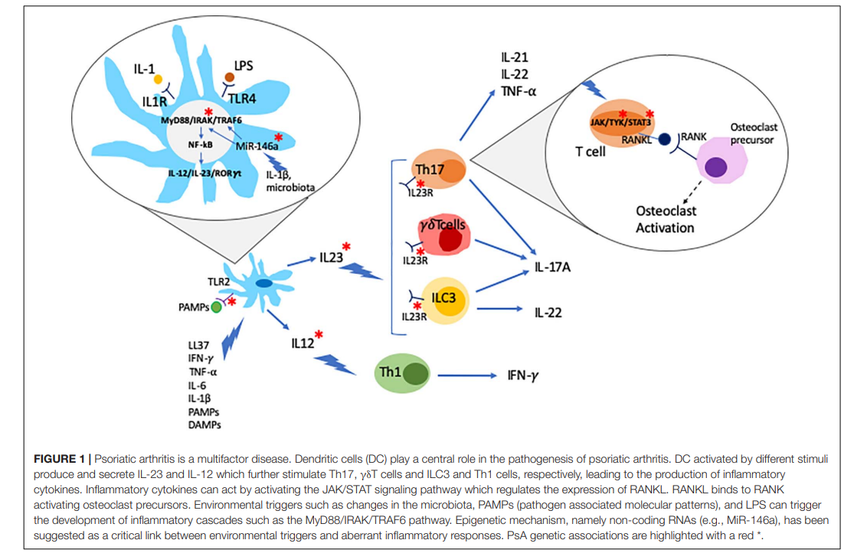
Immunologic Mechanisms
Notes:
אימונולוגיה
פורסמו עבודות עדכניות לגבי הפתוגנזה של המחלה. יודעים שפסוריאזיס מערבת בעיקרה תאי T. בנגעים העוריים יש הסננה של תאי T, דנדריטים ואחרים, יש איקטוב של תאים אלה המפרישים ציטוקינים שונים כמו TNF-a, אך לא רק.

Slide 5
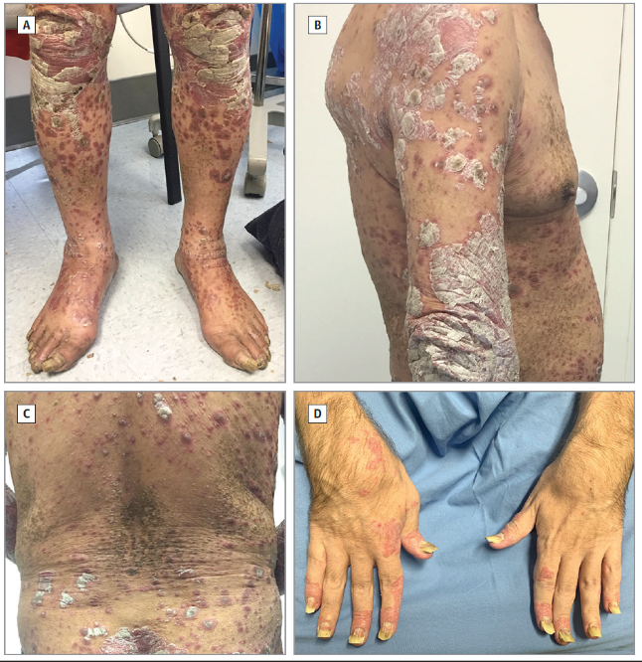
Plaque Psoriasis
Most common morphology (80%)
Well-demarcated plaques
with varying degrees of:
  Erythema (pink to red)
  Scale (desquamation)
  Induration (thickness)

Slide 6
Calculating the Extent of Psoriasis:
1% = Surface Area of the Hand
Psoriasis Coverage and Severity
1%
Mild
Moderate
Severe
<3%
of the body
has PsO
3%-10%
of the body
has PsO
>10%
of the body
has PsO
.
Notes:
PsO, psoriasis.

Slide 7
Etiology & Pathogenesis PSA
Genetic Factors : Susceptibility influenced by particular MHC class I alleles, e.g. HLA-B27, B57, B39, B38
Environmental
  Trauma – Koebner phenomenon: psoriatic lesions arising at site of trauma (24-52%); development of PsA after trauma to joint.
  Bacterial infections - association between guttate psoriasis and streptococcal pharyngitis; up to 30% of PsA synovial tissue-derived T cells proliferate following exposure to group A strep.

Slide 8
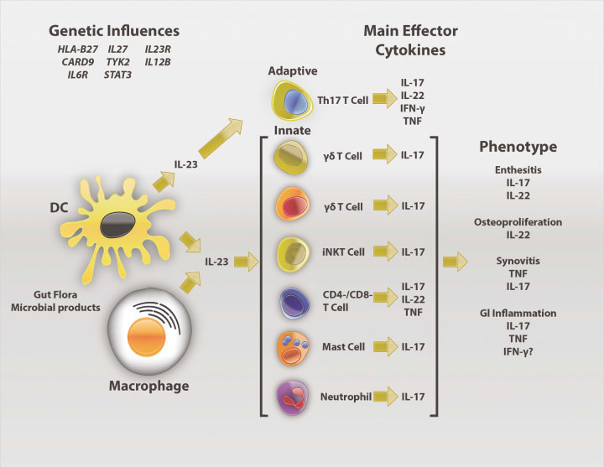
The IL-23/IL-17 axis in PSA
Arthritis Rheum 2014;66(2):231–241
Notes:
Schematic drawing depicting cells, effector cytokines, and possible contributions to spondyloarthritis (SpA) pathogenesis. Dendritic cells (DCs) and macrophages are major sources of interleukin-23 (IL-23), which is produced in response to microbes and their products signaling through pattern recognition receptors. Consequences of HLA–B27 misfolding and endoplasmic reticulum stress can augment IL-23 and IL-1 production, and CARD9 variants could affect production of this cytokine as well.
Cells of both the adaptive and the innate immune response are implicated in SpA pathogenesis. CD4 Th17 cell expansion has been reported, and killer cell immunoglobulin-like receptor 3DL2 Th17 cells may be triggered by surface HLA–B27 dimers on DCs and macrophages to produce IL-17.
Th17 development and survival may be influenced by variants of the IL-23 and IL-6 receptors (IL23R, IL6R), as well as IL-27 and Tyk-2– and STAT3-mediated cytokine responses. Tissue inflammation in SpA involves innate immune IL-17–expressing mast cells (synovium), neutrophils (facet joints), and CD3CD4CD8 entheseal-resident T cells. The latter produce IL-22, which can drive osteoproliferation in rodent models. Variants in IL6R, TYK2, and STAT3 may also affect tissue responses to cytokines.
IFN interferon-; TNF tumor necrosis factor; iNKT invariant natural killer T; GI gastrointestinal.

Slide 9
CLINICAL PREASENTATION
Manifestations include:
Peripheral arthritis
Axial arthritis
Enthesitis
Dactylitis
Skin psoriasis
Nail psoriasis
Other extra-articular manifestations:
Uveitis
Inflammatory bowel disease
.

Slide 10
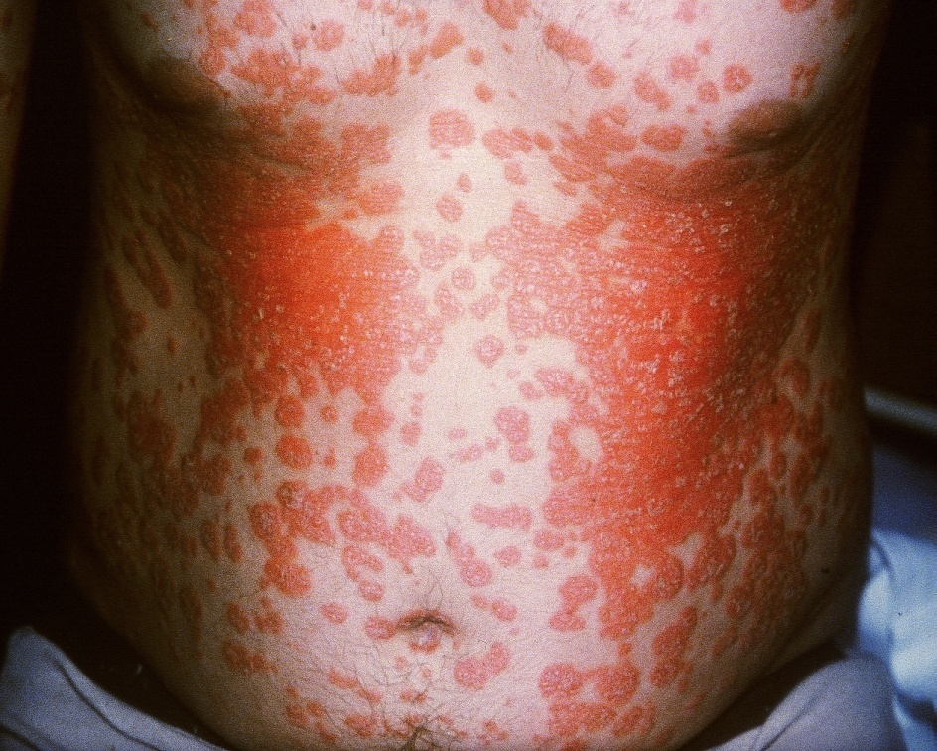
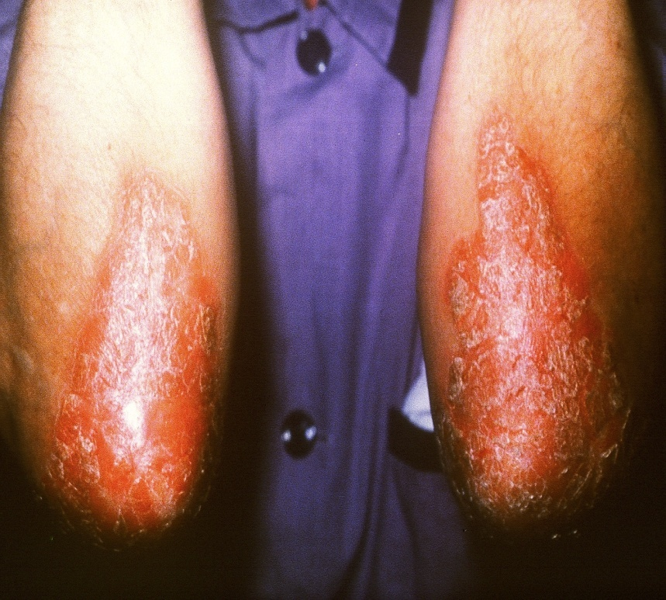
CLINICAL PREASENTATION
Skin & nail changes
lesions are typically occur on the scalp , elbow, behind ears & knees.

Slide 11
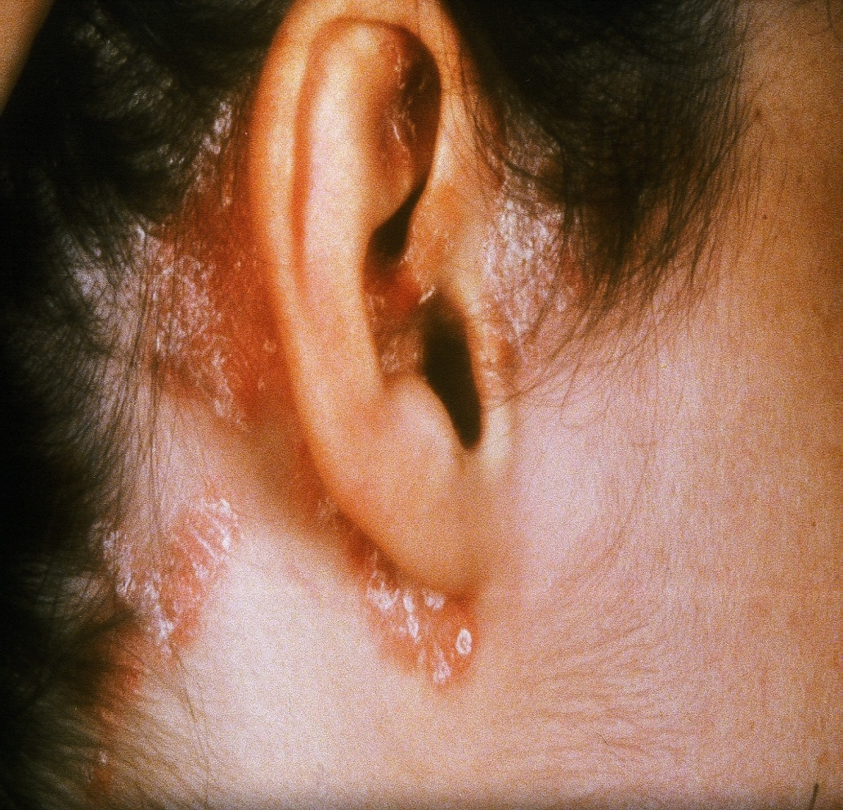
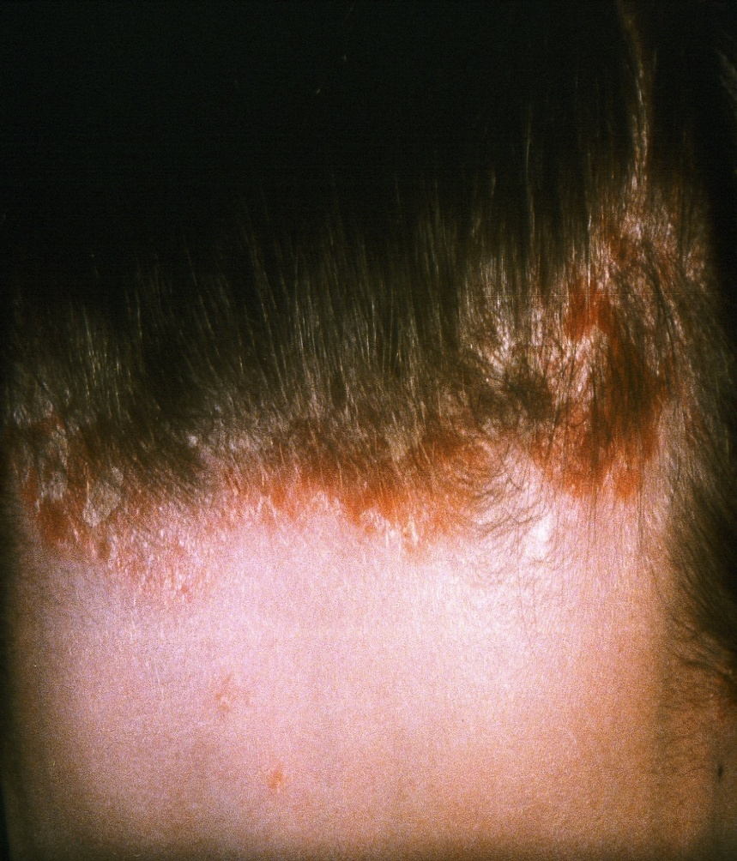

Slide 12
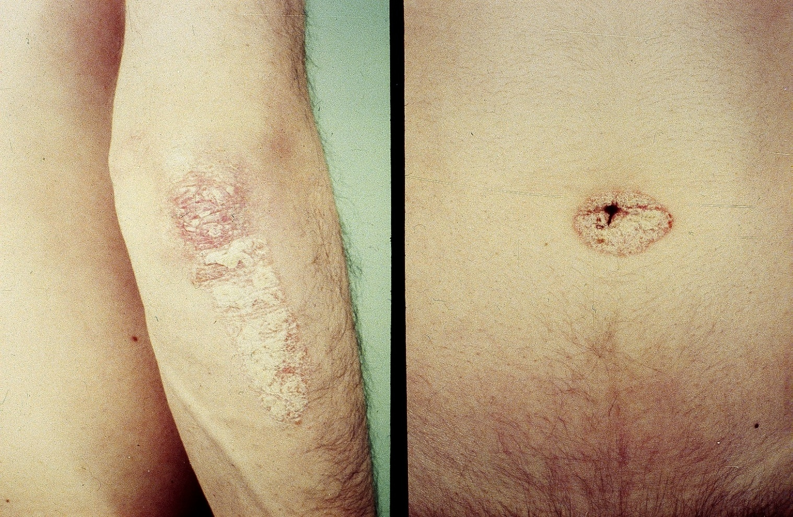
Skin & nail changes

Slide 13
Nail changes
Nail changes include small pits , onycholysis, subungual keratosis , thickening & distortion of nail with ridging. Presence of 20 pits in total is suggestive of psoriasis while presence of more than 60 pits been diagnostic.

Slide 14
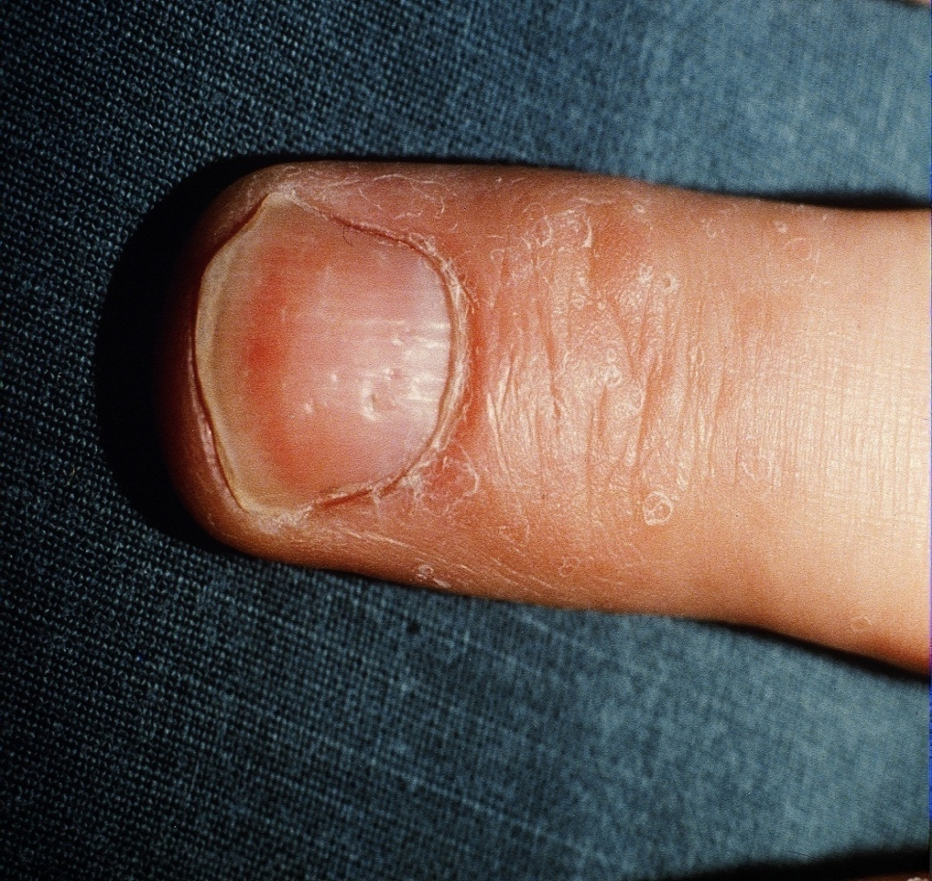
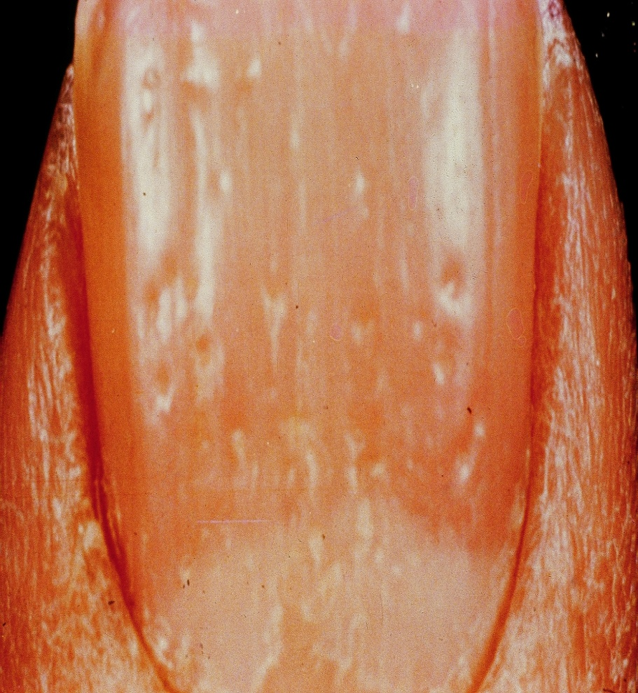
Nail pitting/onycholysis

Slide 15
PsA has an insidious onset & progressive course.
The onset of arthritis is usually preceded by skin disease but may accompany it or the arthritis may precede the skin lesion ( as in children).

Slide 16
Distal arthritis, characterized by involvement of the distal interphalangeal (DIP) joints 5%.
Asymmetric oligoarthritis in which less than five small or large joints 70%.
Symmetric polyarthritis, similar to rheumatoid arthritis 15%.
Arthritis mutilans, characterized by deforming and destructive arthritis 5%.
Spondyloarthritis 5%

Slide 17
Sacroiliac Involvement
  Sacroiliitis in 1/3 of patients
  Usually asymmetric (unilateral)
  May be asymptomatic
Spinal Involvement
  May affect any part of the spine in a random fashion
  Different from ankylosing spondylitis
Entheseal Involvement
Dactylitis
Ocular Involvement

Slide 18
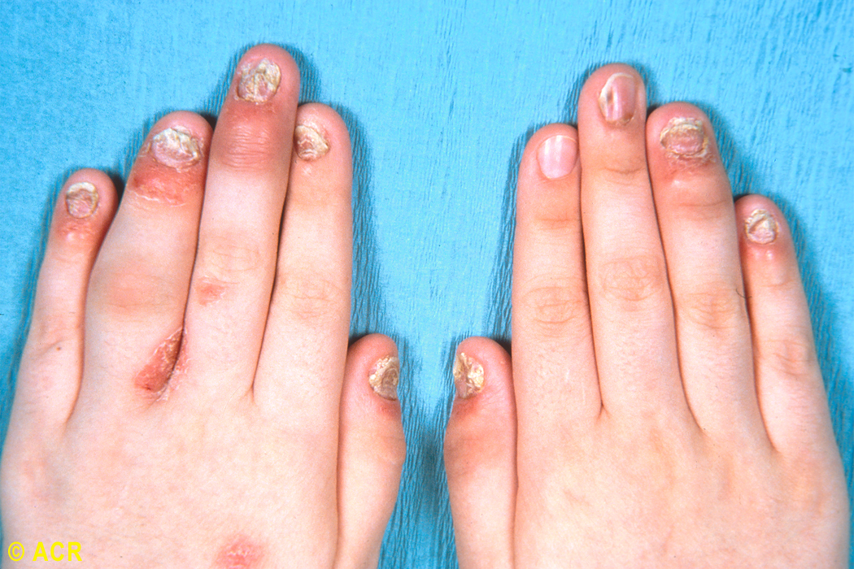

Slide 19
CASPAR Criteria for the Classification of PsA
Inflammatory articular disease (joint, spine, or entheseal)
With ≥3 points from following categories:
  − Psoriasis: current (2), history (1), family history (1)
  − Nail dystrophy (1)
  − Negative rheumatoid factor (1)
  − Dactylitis: current (1), history (1) recorded by a rheumatologist
  − Radiographs: (hand/foot) evidence of juxta-articular new bone formation(1)

Slide 20
Investigation
Elevated ESR in 1/3 of cases, C—reactive protein & complement levels reflect inflammation.
Rheumatoid factors are absent.
Mild normochromic normocytic anemia is seen in chronic cases.
Immunological levels especially IgA level may be elevated.
Synovial fluid is of inflammatory type.
ANA could be positive in low titer & anti ds-DNA in 3% of cases.
Anti-CCP could be positive in 8—16% .

Slide 21
Radiological features of PsA
Lack of juxta-articular osteopenia
Pencil-in cup change
Ankylosis
Periostal reaction
Asymmetric sacroiliitis
Coarse syndesmophytes
Notes:
חולה עם ארתריטיס עם סיפור משפ' של פסוריאזיס או סיפור של פסוריאזיס בעבר.
בממצאי הרנטגן הממצאים טיפוסיים – זה מבחין אותו עם ספונדילו' אחרות. אין פה רק ארוזיות, אלא גם צמיחת עצם ו-ankylosing, לא רק של ה-sacroiliac אלא של המפרקים עצמם (DIP, PIP). במחלות אחרות יש הרס טווח תנועה עקב הרס המפרק ולא עקב ההתאחות.
יש ארוזיה ואפשרות לפתח sacroiliitis ואפשר לפתח גם syndesmophytes.

Slide 22
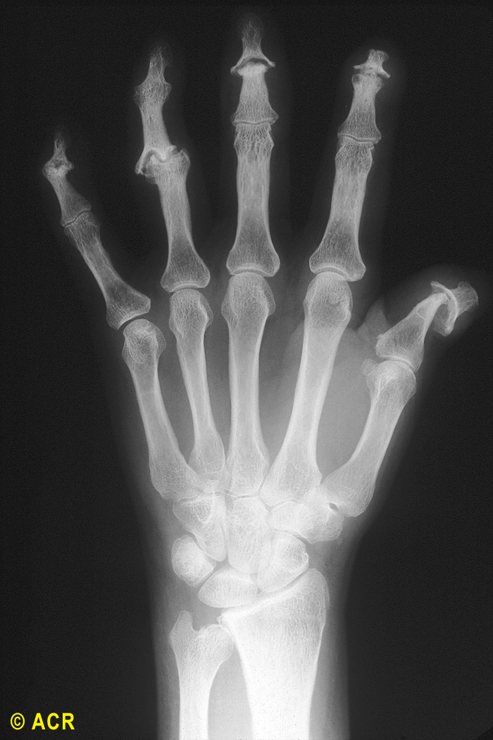
Fusion
Pencil in Cup deformity

Slide 23
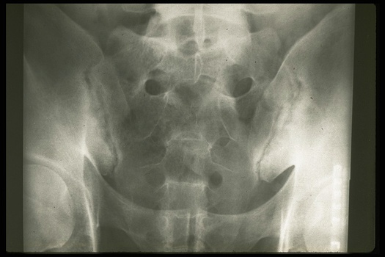

Slide 24
Treatment
NSAIDs.
DMARD ( Sulfasalazine , & Methotrexate ).
Intra-articular steroid could be used in absence of psoriatic lesions around the joint injected.
Systemic steroid is better to be avoided since tapering tends to cause an exacerbation of the skin lesion.
Cyclosporine may be used .
Biological agents Anti-TNF alpha

Slide 25
Management of Patients With Active PsA
Treatment-naive active PsA
Begin with TNFi over oral small molecules, IL-17i, or IL-12/23i
Persistent active disease?
Switch to different TNFi*
Persistent active disease?
Switch to IL-17i*
Persistent active disease?
Switch to IL-12/23i*
Notes:
ACR. American College of Rheumatology; i, inhibitor; IL, interleukin; MTX, methotrexate; NPF, National Psoriasis Foundation; PsA, psoriatic arthritis; TNF, tumor necrosis factor.

Slide 26
Reactive Arthritis
Sterile synovitis , following an extra-articular infection
The microbial pathogens commonly associated with reactive arthritis are shigella , salmonella , yersenia , campylobacter & Chlamydia.

Slide 27
Many reactive arthritis occur after a known infection & therefore have named post- infection.
Reactive arthritis begins as asymmetrical oligoarthritis often precede by an identifiable infectious event by one to four weeks.

Slide 28
Reactive Arthritis
Male – Female ratio 4 to 1
HLA-B27 75 %
Onset Simultaneous or
over 3 – 4 weeks
Course Self limited
Relapsing

Slide 29
Reiter’s Syndrome
This syndrome consists of the triad of
reactive arthritis
nonspecific urethritis
Conjunctivitis

Slide 30
Clinical Manifestations
Onset 7- 30 days after self limited specific enteric or venereal infection
Peripheral arthritis: acute, highly inflammatory asymmetric arthritis involving knees, ankles, toes,
Usually an oligoarthritis with 2-4 joints involved
Dactylitis (Sausage digit) (40%)
Enthesitis - plantar fascia and Achilles tendon (40%)
Sacroiliitis
spondylitis with asymmetric involvement of only one or two vertebral units (50%). More extensive vertebral “squaring

Slide 31
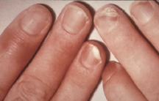
Clinical features
Onychodystrophy with hyper- and para-keratosis. Often subungual
Conjunctivitis (often first manifestation). Uveitis may appear in recurrent disease
Non specific urethritis
Painless circinate balanitis , keratoderma blenorgica and mucosal ulcers

Slide 32
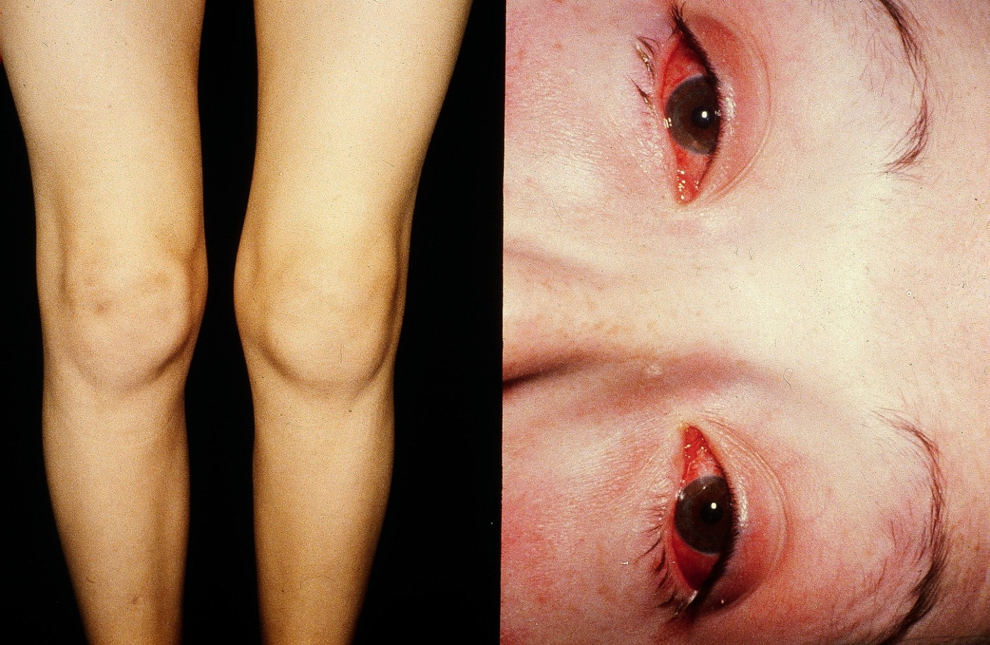
Arthritis Conjunctivitis

Slide 33
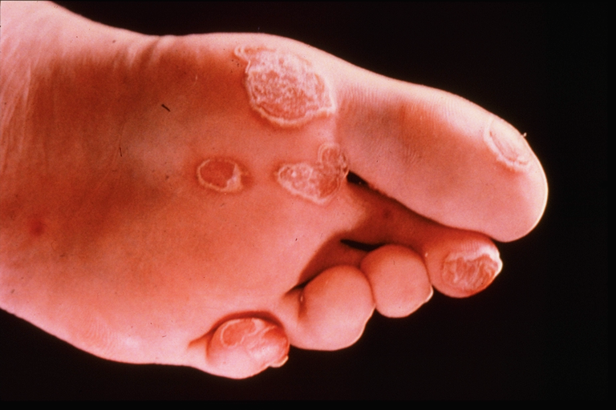
Keratoderma Blenorrhagicum

Slide 34
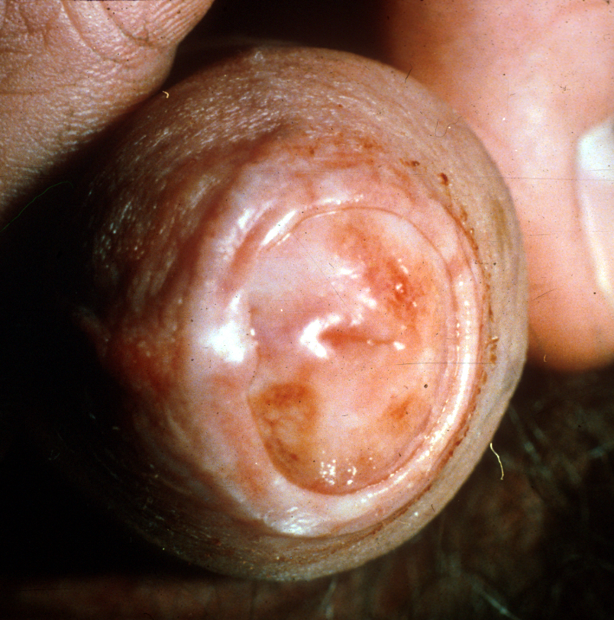

Slide 35
Treatment
NSAIDS are the first line of treatment.
In patient with frequent recurrences or chronic arthritis benefit from DMARDS such us sulfasalazine or methotrexate.
If there is axial involvement they will benefit from TNF-alpha blockers.
Topical steroids are indicated in conjunctivitis and uveitis.
In monoarthritis steroid injections could be beneficial.

Slide 36
ARTHRITIS AND INFLATORY BOWEL DISEASE
The arthritis accompanying the inflammatory bowel diseases
(IBDs)-Crohn’s disease (CD) and ulcerative colitis (UC)
Peripheral Arthritis
The arthritis is typically pauciarticular and asymmetric,and may occur in a migratory pattern in some patients.
The arthritis is typically non-erosive, occurring in intermittent attacks lasting up to 6 weeks
There is a predilection for lower extremity joints
The activity of the peripheral arthritis correlates well with the degree of active bowel inflammation, particularly in UC

Slide 37
Axial Arthritis
The axial pattern of enteropathic arthritis is indistinguishable clinically and radiographically from primary AS.
Unlike the peripheral arthritis, axial disease in
IBD does not parallel the activity of the bowel disease,

Slide 38
Treatment
NSAIDs are first-line treatment for joint inflammation in both axial and peripheral disease.
Sulfasalazine, which has a role in the treatment of
colonic inflammation in IBD, has been effective in treating peripheral, but not axial.
Anti-tumor necrosis factor therapies have had a major impact on the therapeutic approach to IBD and to the associated joint diseases.

